Slide 1
Proactively Positioning CO on Federal Health Policy
Health Care in Your Future Summit
April 5, 2017

Slide 2
Background
Health care a significant part of CO’s economy:
Health & Wellness: 16,400 companies, 315,000 jobs, 17.4B in payroll
BioScience products are CO’s leading export
For better or worse (depending on your perspective), Colorado has largely embraced Affordable Care Act
Connect for Health CO, state-based exchange marketplace
Medicaid expansion
State Innovation Model grant
Colorado overwhelmingly rejected Amendment 69
79 percent NO vote

Slide 3
Background
November 2016 Election: results bring promise of MAJOR change to federal health policy framework
Candidate Trump: “Repeal it. Replace it. Get something great.”
Speaker Paul Ryan: Better Way Plan
December 2016: “ACA Two-Step” strategy emerges
Repeal & then Replace
Uncertainty bad for health care industry, bad for consumers (business & individual), bad for state govts

Slide 4
CO Health Policy Coalition
“Big Tent” approach comes together Dec 2016; cast net wide to include:
Business and Economic Development
Health Care Providers
Insurers and Brokers
Consumer Advocates
Public Health & Local Government
Philanthropy
Goal: Proactively position Colorado to help shape the federal conversation about the future of health care
1st Step: Developed Shared Principles

Slide 5
Principles
Process Principles:
Repeal only with a clearly identified and carefully considered replacement plan.
Given the interconnected nature of health care addressing component policy pieces in isolation could have significant, negative unintended consequences.
Find a non-partisan path to a new federal health care framework.

Slide 6
Principles
Policy Principles
Expand choice, affordability and competition in private markets, while maintaining consumer protections.
Promote stability in the market in order to help control costs.
Recognize that promoting access to care at the right time in the right setting by ensuring access to coverage has benefits for people, the health care system and our economy.

Slide 7
Principles
Don’t adopt strategies that shift cost from the federal government to state budgets without sufficient and sustained federal funding or create an uneven playing field in the health care market.
Protect the most vulnerable populations.
Empower rural communities.
Encourage health care transformation at the state and community levels with continued federal investment to lower the cost and improve quality of health care.

Slide 8
What Is It? Who Is Involved?
Dec 20 to Jan 3: Got more than 100 organizations to endorse principles; Today more than 115 groups signed on
Operating as a very loose coalition; primary objective is to share information and serve as a resource to support individual advocacy efforts
No financial or other resource commitment; open table
Informal leadership group provides strategic guidance and input to consulting team supporting the effort

Slide 9
Coalition Activities
Sent 2 Letters to Gov Hickenlooper & CO Congressional Delegation communicating shared priorities generally and specifically on Medicaid
Generated News & Editorial Coverage
Colorado business, liberal groups join forces to warn against repealing Obamacare, Denver Business Journal, Jan 4
A recipe for disaster? Editorial, Grand Junction Daily Sentinel, Jan 6
Fix, don’t repeal Obamacare, Editorial, Denver Post, Jan 7
ACA has offered tangible benefits in Northern CO, Guest Opinion, Loveland Reporter Herald, Jan 18
What’s next for health care? Guest Opinion, Vail Daily, Jan 19
Improve health care system; don’t just dismantle it Guest Opinion, Pueblo Chieftain, Jan 22
Email Updates with News & Resources every 7 to 10 days
Educational meetings on key topics

Slide 10
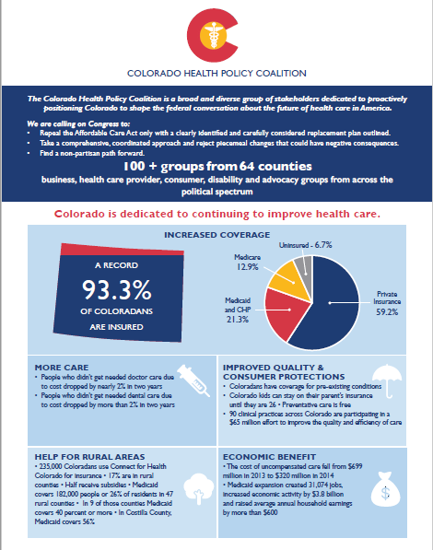
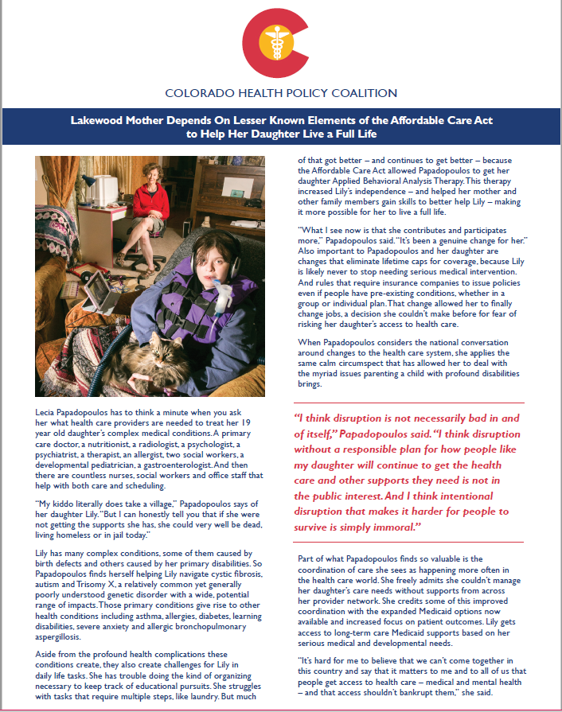
Coalition Resources

Slide 11
Recent Developments
March 6: Speaker Paul Ryan introduced the American Health Care Act with support of Trump administration
Was approved by 3 committees in the House despite lack of support from major stakeholder groups, comments of concern from members of the Senate, including Republicans
March 24: Speaker Ryan withdraws the bill after failing to garner enough support to pass it; “Freedom Caucus” played key role in failure
Ryan: “We are going to be living with Obamacare for the foreseeable future”
March 25: President Trump tweets: “ObamaCare will explode and we will all get together and piece together a great healthcare plan for THE PEOPLE. Do not worry!”

Slide 12
Major Issues In Play
Future of Medicaid – Program Eligibility & Financing
Future of Subsidies / Tax Credits for Private Insurance
Mandates for Coverage
Private Insurance Market Regulations
Public Health & Prevention Funds
State Innovation, Delivery System Reforms

Slide 13
Possible Next Steps
Changes Possible Via Administrative Action
Relaxation of Essential Health Benefits
Reexamination of some Preventative Services, particularly in women’s health
Cost-sharing reductions
Loosening of criteria for grandfathered plans to allow more to continue
Issuing of new guidance on eligibility and enrollment
Changing support for and policy for federally facilitated marketplaces
Supporting congressional efforts to change the ACA already in motion including by withholding risk-corridor payments and challenging in court federal responsibility for cost-sharing. The Trump administration could stop defending the law in that case. If Congress wins the case, health plans, not the federal government will be responsible for making those payments.

Slide 14
Possible Next Steps
Congressional Activity
2 Republican bills have been introduced in the Senate
The Obamacare Replacement Act from Sen. Rand Paul of Kentucky
The Patient Freedom Act of 2017 from Sen. Susan Collins of Maine, Sen. Bill Cassidy of Maryland, Sen. Shelley Moore Capito of West Virginia and Sen. Johnny Isakson of Georgia
Democratic House and Senate leadership have written President Trump expressing interest in working with him to improve the Affordable Care Act

Slide 15
Looking Ahead
Uncertainty persists in volatile political environment
Value in continued collaboration
Information exchange & shared learning
Opportunity to support individual organization advocacy
Responsive / reactive to changing environment

Slide 16
Q & A
For More Information:
michele@micheleamesconsulting.com

