Slide 1
Virtual reality at UCHealth

Slide 2
Technology to inspire.
Notes:
Human connection. Rendever story. Talk about outpatient infusion and why we started with that area.

Slide 3
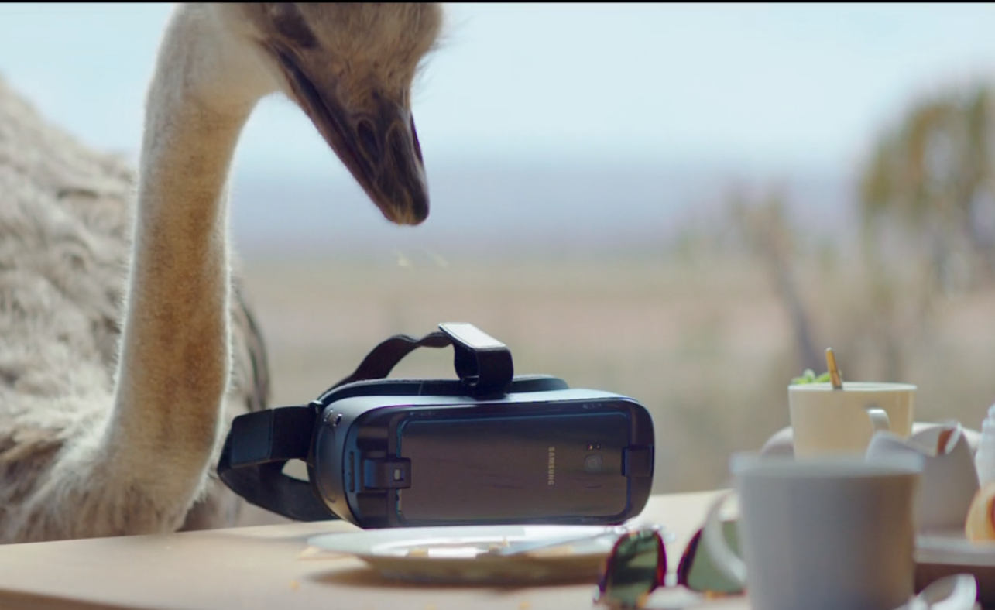

Slide 4
Patients are at different points along their journey
Here we go again.
It’s not good….I don’t feel good [crying].
There’s always apprehension…but to be honest I’ve been looking forward [to my treatments] because it’s working.
Female, 64 – Fort Collins
Female, 26 – Denver
Male, 56 – Fort Collins
I want to get through the day without being sick.
I don’t like coming [takes anti-anxiety medication before every treatment].
…and then you sit here all day bored.
Male, 60s – Colorado Springs
Female, 63 – Fort Collins
Female, 57 – Denver
Cancer is….different. You don’t have many people talk to you. My wife, she don’t say much, she keeps to herself anymore.
Beyond the physical toll, cancer is emotionally hard – especially to see others go through it with you. I’m depressed, I don’t like how cancer affects my family and hurts the people around me.
Male, 63 – Denver
Male, 50 – Denver

Slide 5
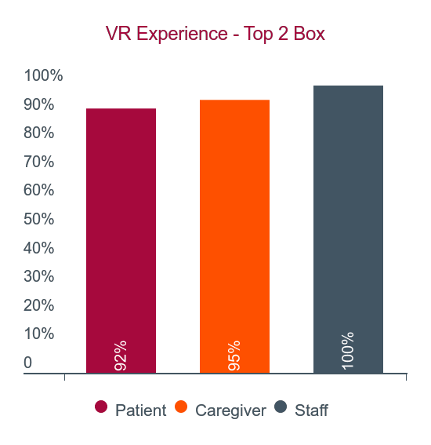
Initial pilot in 2018: Overall experience with virtual reality

Slide 6
Six overall themes around virtual reality
Gave patients something to look forward to
Created an atmosphere where the concept of time disappeared
Was not just a distraction, but an escape from their environment
Was also an escape from their illness – even if for a brief moment
Altered mood and, in some cases, reduced anxiety
Gave patients the freedom to live extraordinary lives
I want to travel and do things, but I can’t with my disease. Virtual reality immerses you, blocks everything else out. I felt free.
This is incredible, it took me away for a minute…out of the element of this place and I didn’t think about my cancer or this place.
Takes you out of this bubble and puts you into another bubble.
It changed my mood…because when I was talking, I was crying and now when I see it, I feel happy.
You get something cool to go back and say ‘hey look what I did when I had chemo today’ instead of just ‘I had chemo today’.
Virtual reality separates you from the visual reminders/cues of a difficult environment. It helps reduce anxiety and bring comfort, and distracts you from delays. It’s outside of time.
Female, 42 – Fort Collins
Female, 26 – Denver
Male, 45 – Denver
Nurse Manager – Colorado Springs
Male, 50 – Denver
Female, 23 – Colorado Springs

Slide 7
Use cases and expanding across UCHealth
Virtual Reality Use Cases and Locations
Use cases
Locations
15,000
Virtual reality moments at UCHealth
Needle aversion
Fear / Anxiety
Long treatments
Palliative Care
Painful treatments
Meaningful experiences
Cancer Care/Infusion clinics
Dialysis clinics
Laboratory
Wound care
Burn care
Pre-procedure / Surgery waiting
Employee health and wellness
Hospital inpatient
“I have always wanted to go on a hot air balloon ride and haven’t been able to because of my chronic condition and covid. This virtual experience distracted me from my wound care treatment and made me feel like to I got experience a hot air balloon ride.”

Slide 8
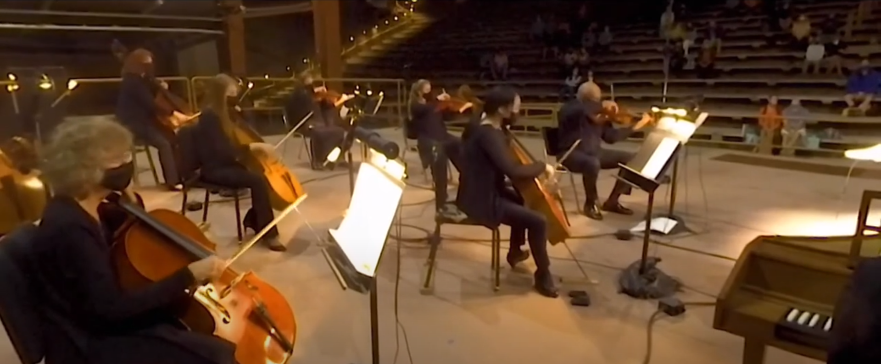
Partnership collaboration: Colorado Symphony
An infusion patient had been asking for more classical music on our platform.
Colorado Symphony played at Red Rocks in 2020 to a limited audience, and we jumped the chance to see how we could get involved.
An immediate “yes” from the Symphony led to one of our most meaningful collaborations.
“[The performance was] a destresser. Stress increases your pain levels. It messes with your sleep. [With VR], you're just immersed in this experience." "You don't think about, 'Oh my God, I have cancer.' This is really an escape."

Slide 9
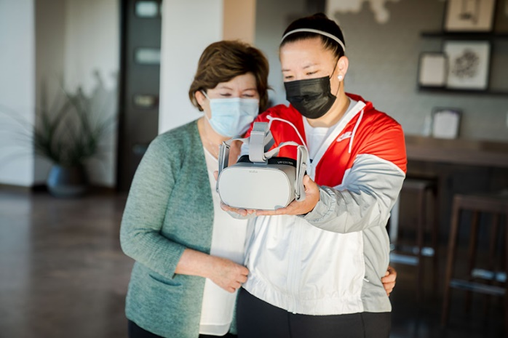
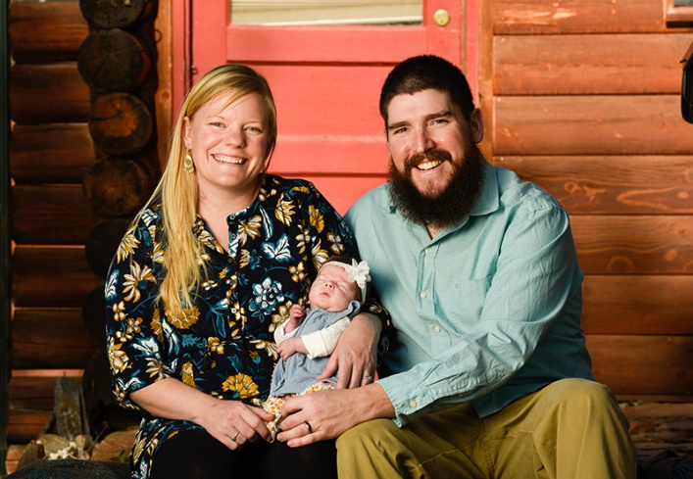
Pandemic collaboration: COVID-19 Vaccine
Amy Watanabe
Sarah Mays
COVID-19 vaccine clinic - MCR
An “innovative mindset”: Kate Johnson, NP, called us and asked about VR for Amy. A couple weeks later, she was vaccinated.
Sarah contracted COVID while pregnant and had a 20% chance of survival. When it was time to get vaccinated, we were contacted to help out.
Our VR lead at the MCR vaccine clinic – helped patients overcome their fear of needles.
Amy’s story prompted calls from people with the same fear. We turned that to action. One of those patients is Sarah Mays.
We met Sarah at MCR for both shots of Pfizer and she swam with dolphins with no fear or anxiety.
The workflow was documented to help us understand how to operationalize VR in laboratory settings.
Amy Watanabe
UCHealth Today | DaysTech
Sarah Mays
Loveland Reporter Herald | The Denver Channel

Slide 10
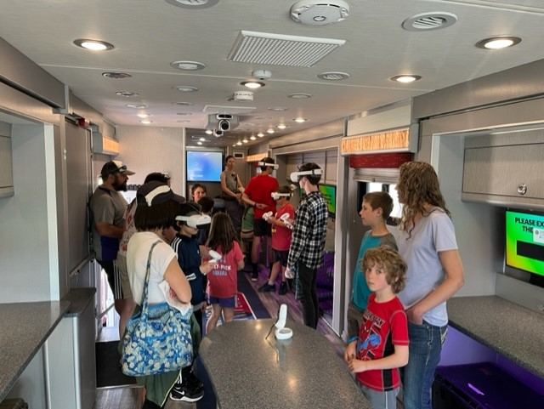
Community collaboration: St. Vrain School District Innovation Center
UCHealth and St. Vrain School District partnered on a Design Thinking project to focus on “Joy, Empathy, and Connection” among students.
The students chose Virtual Reality as the platform and created custom content focused on the 8th grade to 9th grade school transition.
Participating students reported a 24% decrease in anxiety levels after the VR tour of their new school.
“You are consistently ideating and creating something to try to make it better and better for your school and for your community. It’s a really cool representation of how the scientific method can go from ideas in your head to products, to helping people, Violet, St. Vrain Junior"
“[The project was about] celebrating humans helping humans. Justin Ross, UCHealth"

Slide 11
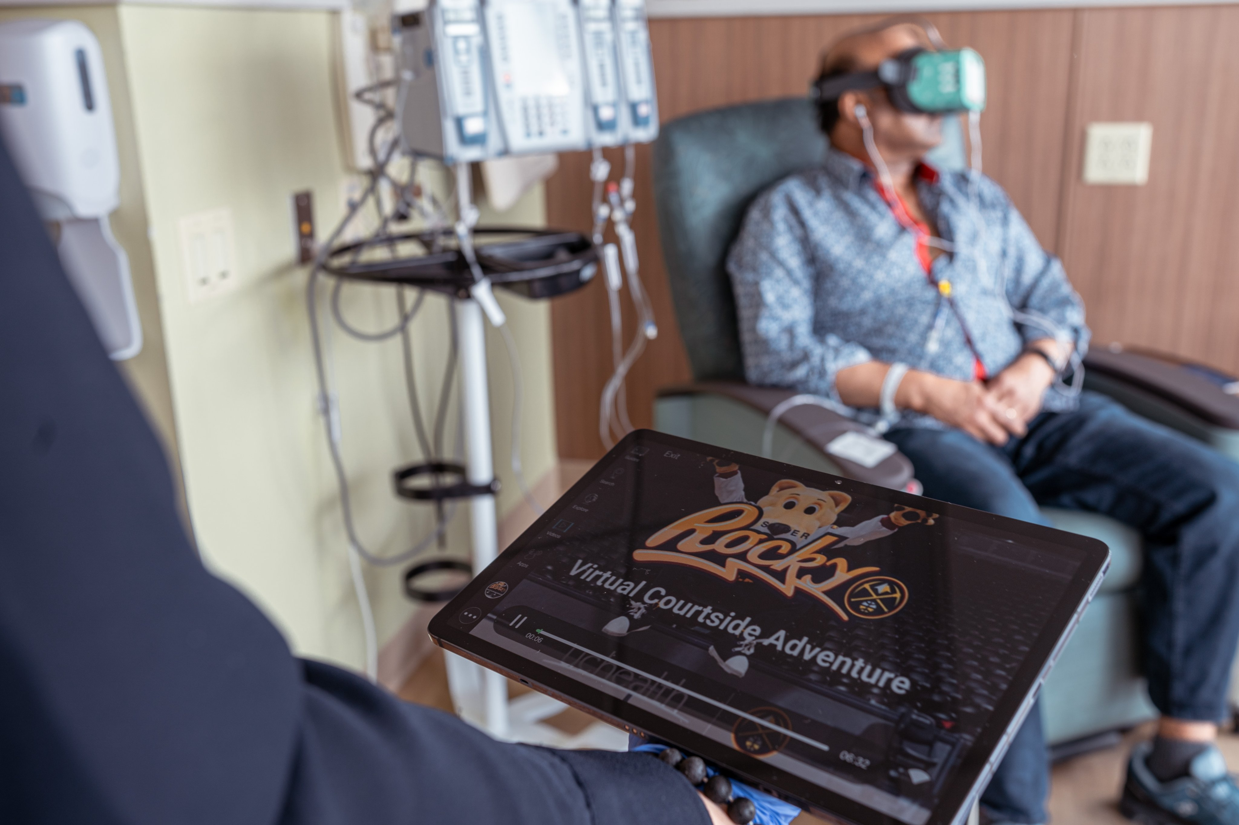
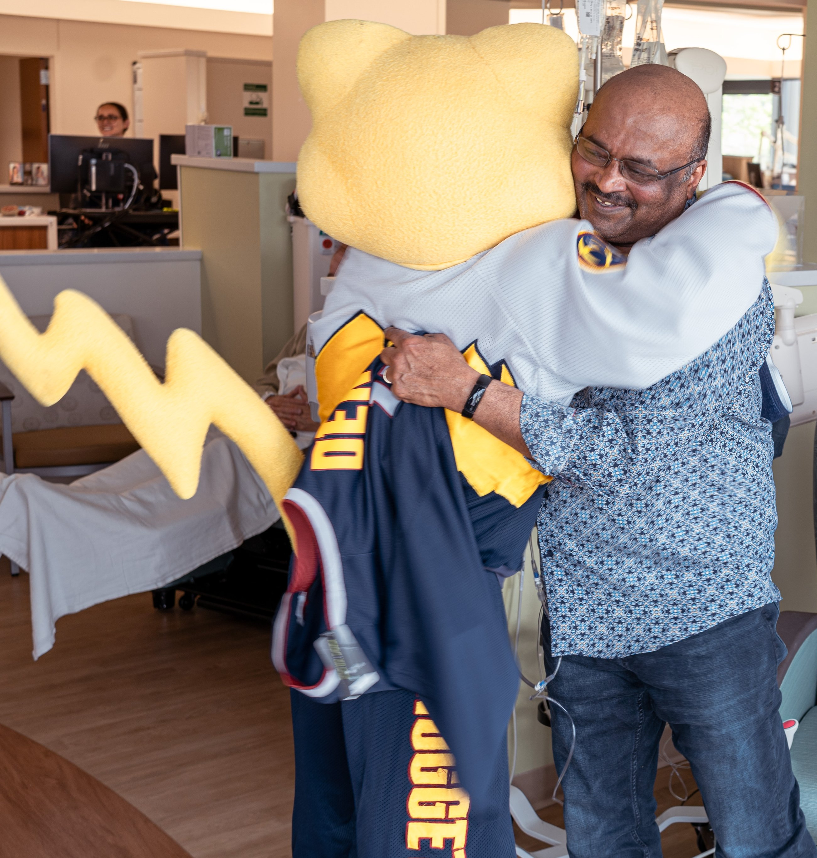
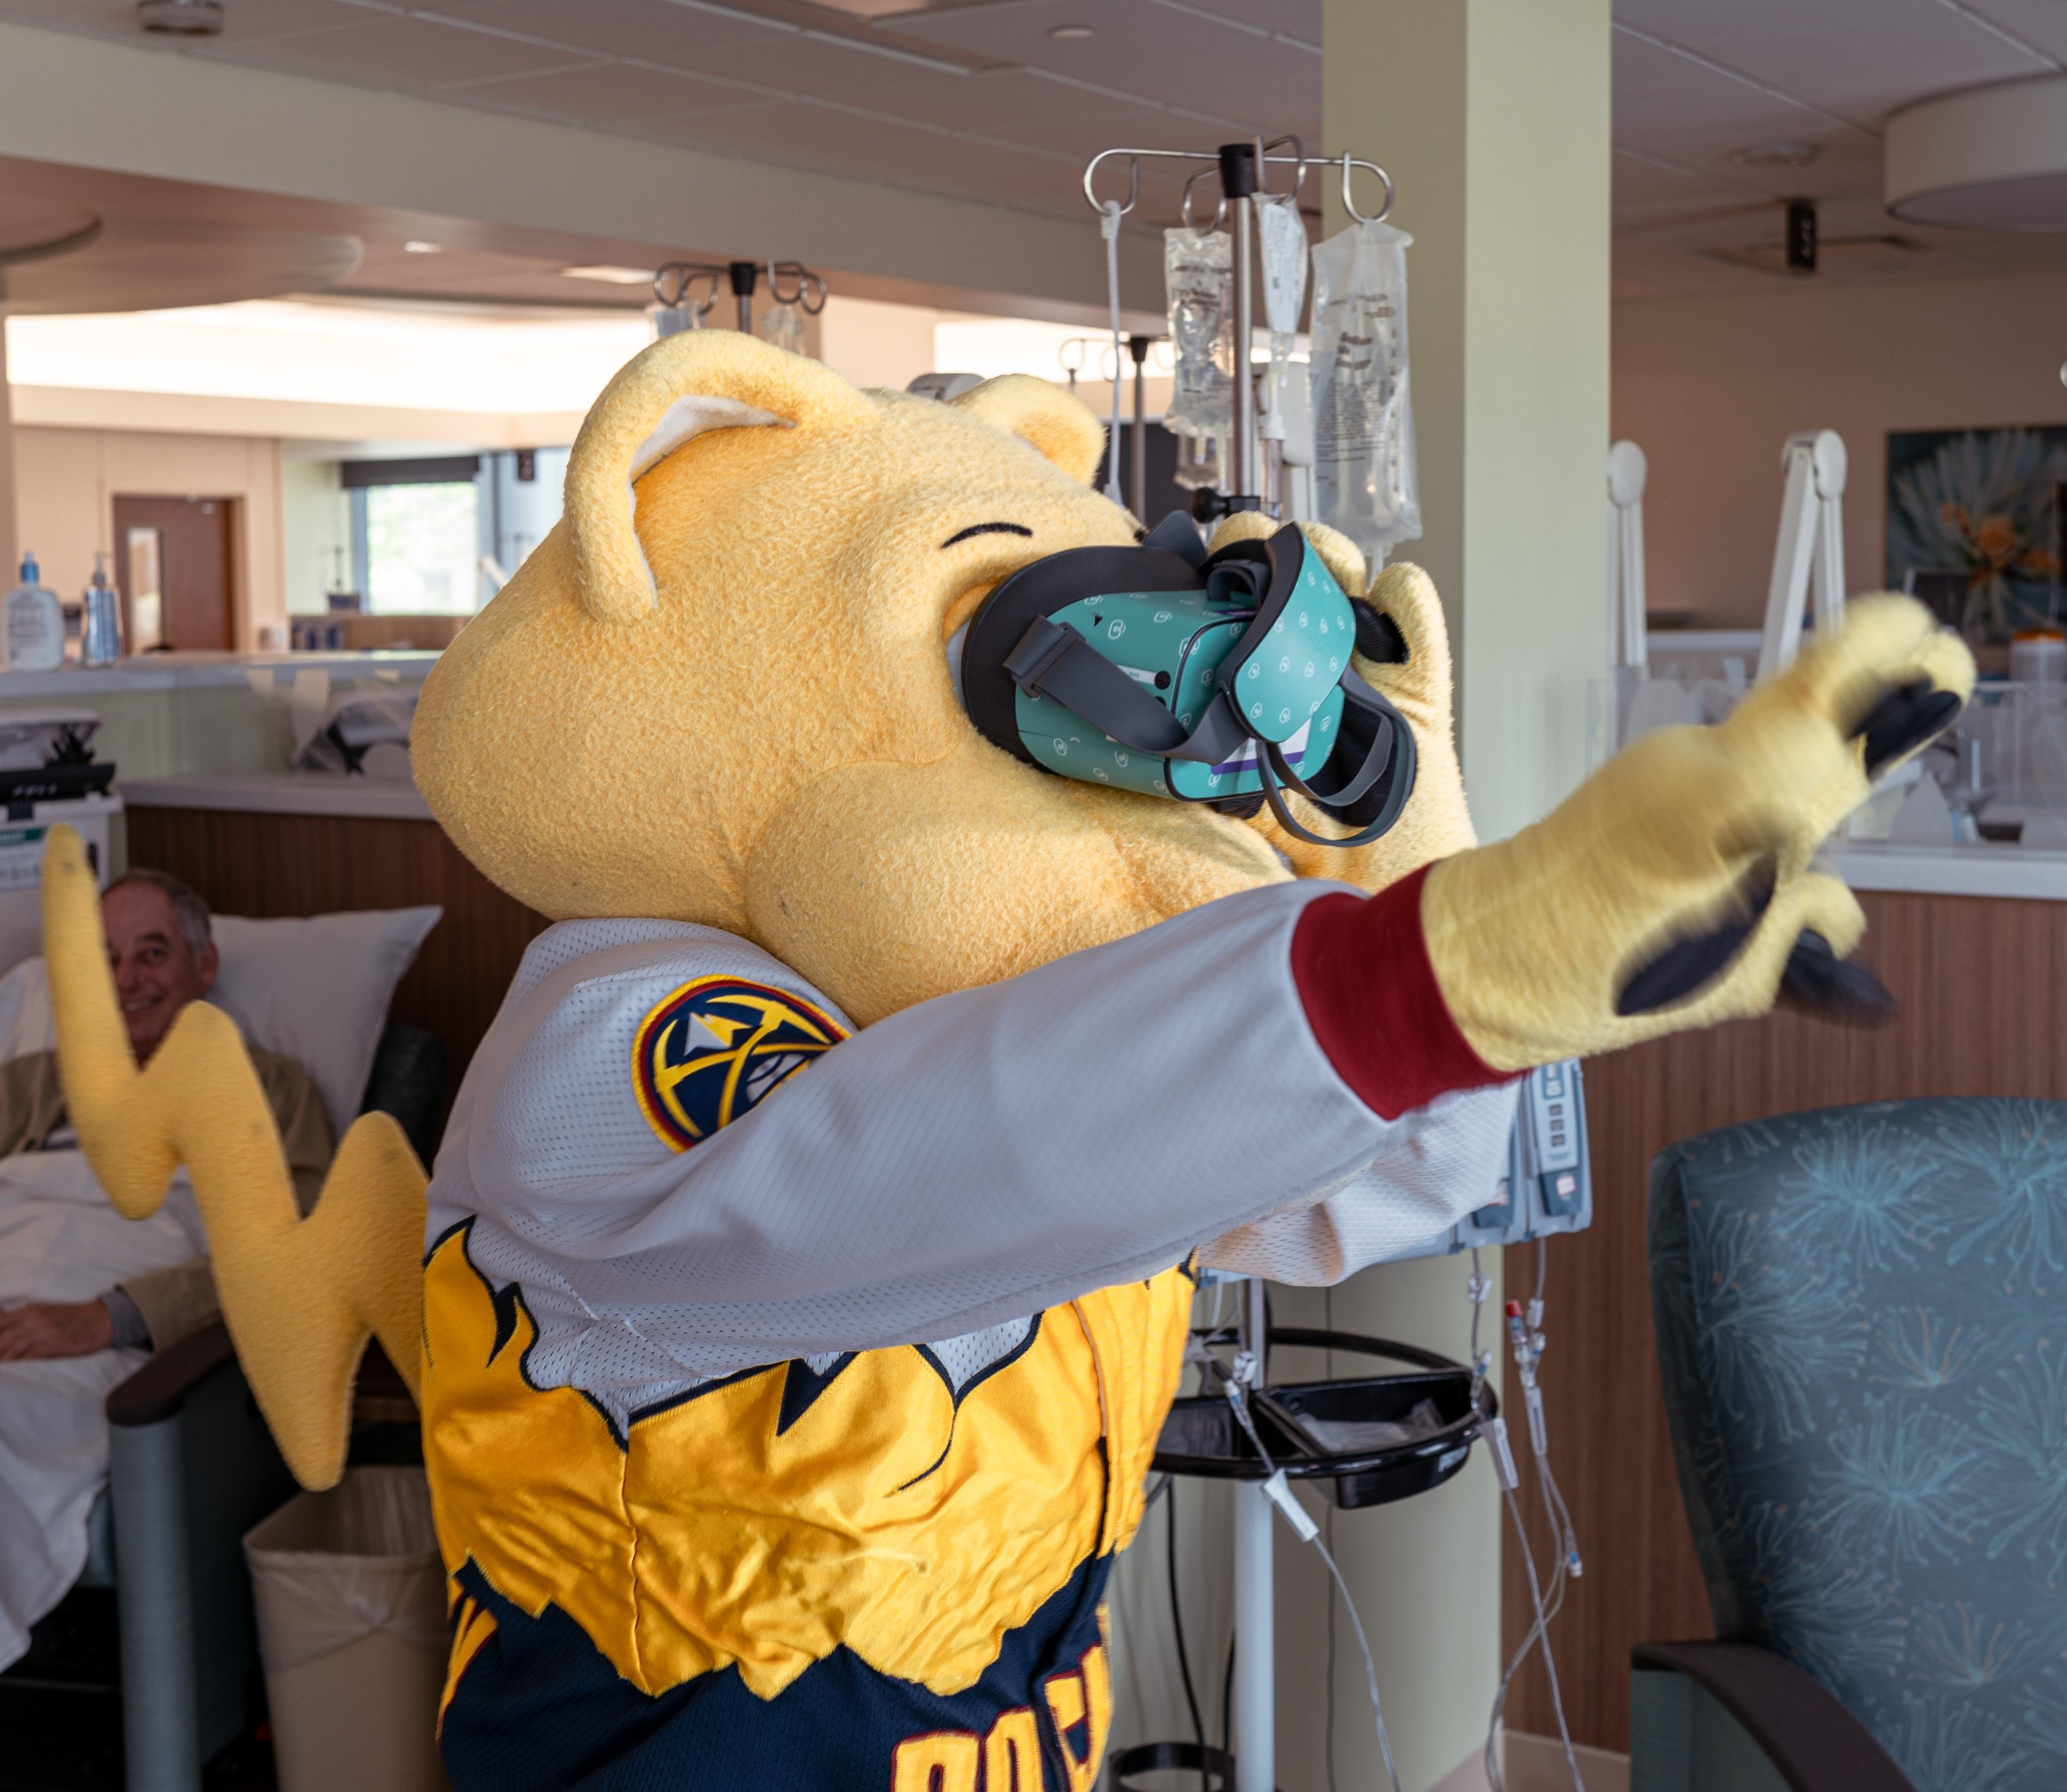
Technology to enhance human connection. Thank you.

